Slide 1

LibroWave
OSCAR MANUEL CONCEPCION NAPOLES
MARYAM NADHIM EDAM, EDAM
SMAIL DAHMANI

Slide 2
Contenido
Presentación del Documento de Visión del proyecto LibroWave, una plataforma desarrollada para facilitar el alquiler de libros físicos y en línea. LibroWave está diseñado para agilizar el proceso para que los bibliotecarios administren sus colecciones de libros y permitir a los lectores descubrir, reservar y alquilar fácilmente los libros disponibles.
LibroWave propone una solución digital que permite a los bibliotecarios exhibir sus colecciones de libros y permite a los lectores explorar títulos disponibles, reservar libros y completar transacciones de alquiler sin problemas, así como valorar y comentar los títulos leídos. Al aprovechar la plataforma en línea, LibroWave pretende cerrar la brecha entre bibliotecarios y lectores, creando un entorno dinámico y accesible para los entusiastas del libro.

Slide 3
Tabla de Contenidos
Wireflow& HTA
01.
03.
Arquitectura de la información
05.
Prototipos
02.
Mapa de Navegación
04.
Bocetos
Notes:
First we will start with Information architecture

Slide 4
Organization structures
The registration and profile creation screens will follow a linear structure, gradually presenting the necessary information to the user.

Slide 5
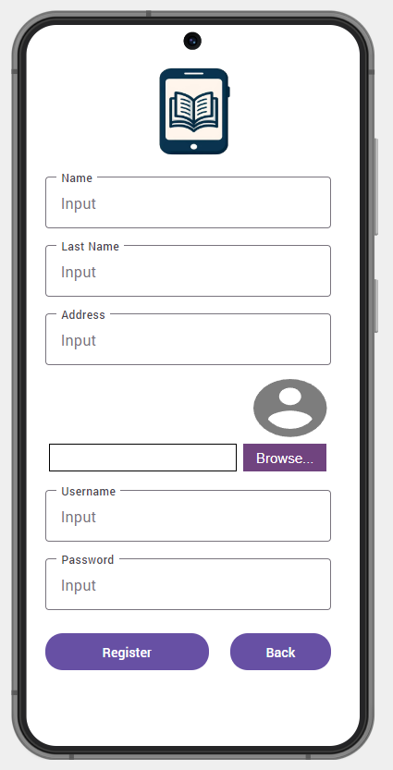
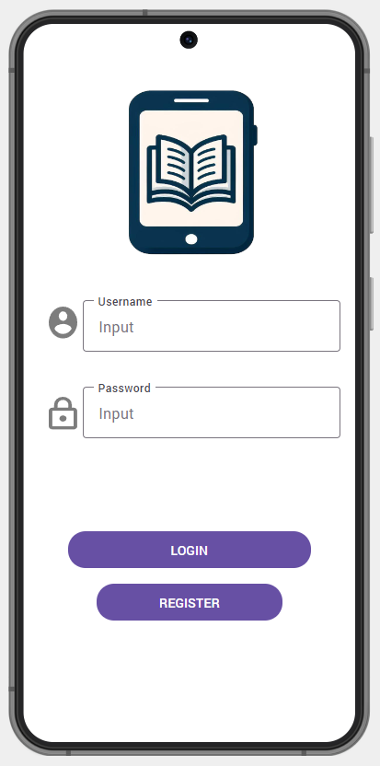
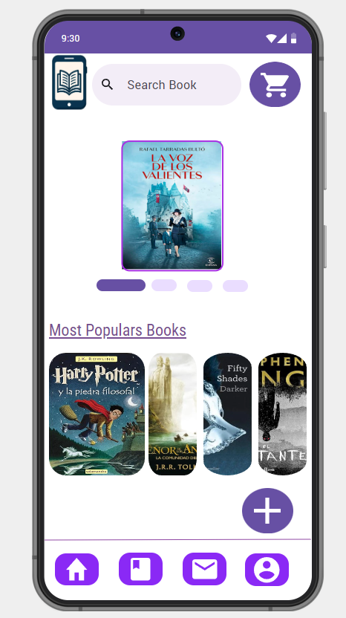
Register
Login
Home

Slide 6




Navigation system
Once logged in, the main screen will adopt a sectional structure.
To ensure a user-friendly experience, the app's navigation is structured as follows
Home
Books
Notification
Profile

Slide 7
Navigation system
Home
Serves as the central hub, providing an overview and quick access to key features.
Users can explore various sections of the app from the home screen.

Slide 8
Navigation system
Home

Slide 9
Navigation system
Books
Dedicated to discovering available books for rent.
Allows users to browse and explore the collection of books.

Slide 10
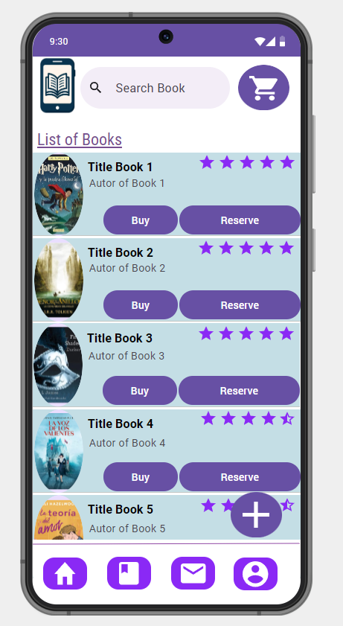

Navigation system
Books

Slide 11
Navigation system
Notifications
Displays all the user notifications and alerts.
Facilitates the management and participation in forum discussions.
Users can discuss books, share recommendations, and engage in literary topics.

Slide 12
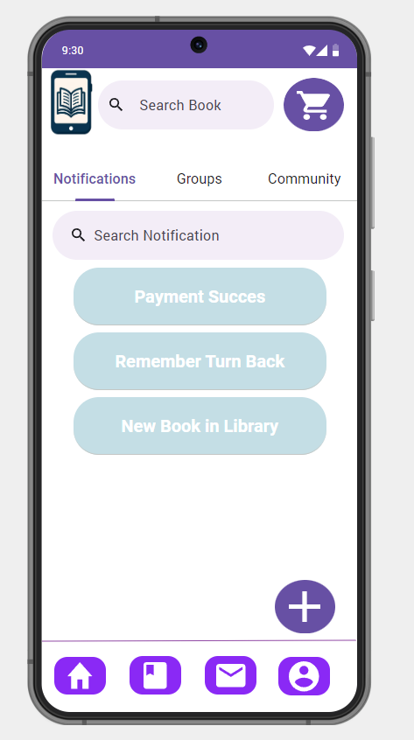
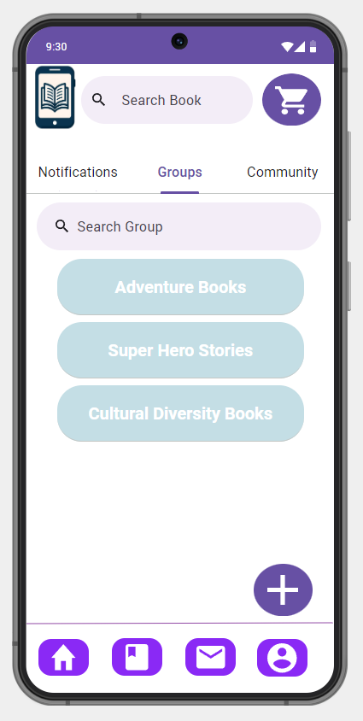
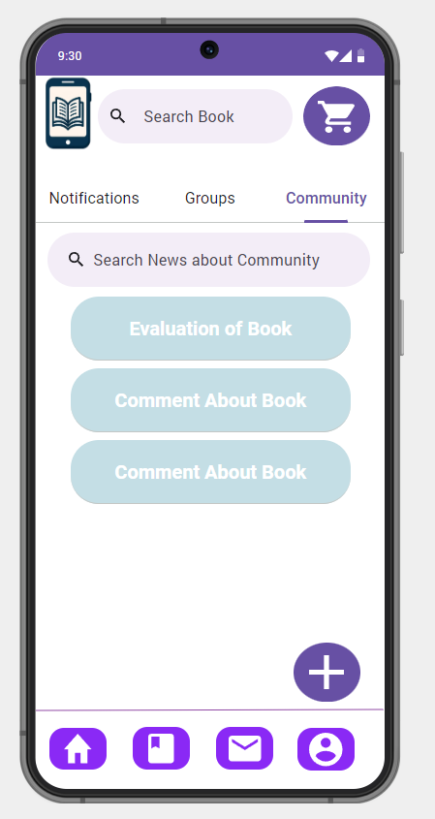
Navigation system
Notifications
Groups (Forums)
Community (discussions)

Slide 13
Navigation system
Profile
A profile section where users can view their personal information & settings with the ability to edit.
Display information about user and subscription state and offers, also contains the latest books read by the user and favorite books.

Slide 14
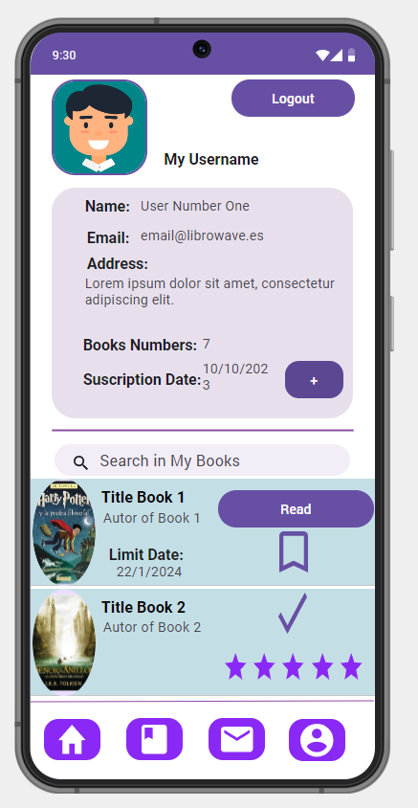
Navigation system
Profile

Slide 15

Search system
Search for Known Items:
In the "Books" section, users can swiftly find specific books using the search bar based on titles, authors, or other details.

Slide 16
Search system
Search for Availability:
The search bar dynamically updates information in real-time as users type, offering a responsive search experience.
Users can search for books by entering partial titles, authors' names, or other relevant details.

Slide 17
Search system
Exploratory Search:
Default recommendations in the "Books" section are tailored to user preferences, aligning with their literacy interests.
Advanced search options are available, allowing users to search by genre, date, language, or thematic focus.

Slide 18
Search system
Comprehensive Searches:
Clicking on a search result provides comprehensive information about the book, including a summary, author details, and other relevant data.

Slide 19
Concept Diagram
In the following diagram, we outline the key sections of LibroWave app
encompassing Book exploration, Reviews, Cart management, and Forum discussions.

Slide 20
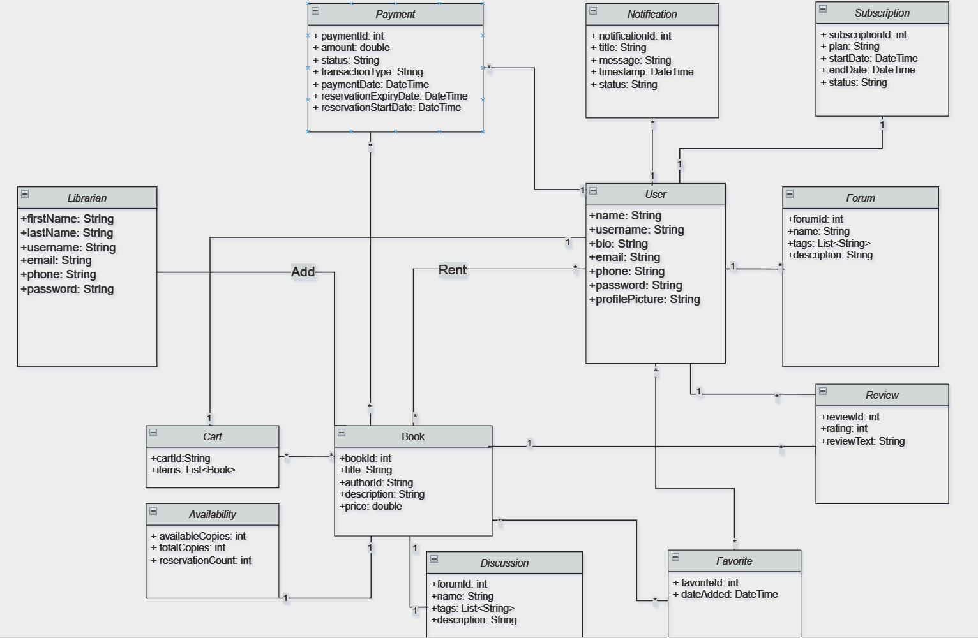

Slide 21
Tabla de Contenidos
Wireflow& HTA
01.
03.
Arquitectura de la información
05.
Prototipos
02.
Mapa de Navegación
04.
Bocetos

Slide 22
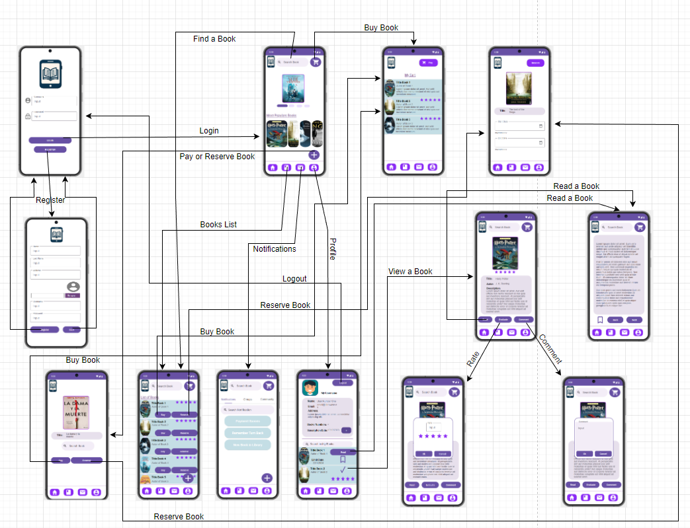
Navigation Map

Slide 23
Tabla de Contenidos
Wireflow& HTA
01.
03.
Arquitectura de la información
05.
Prototipos
02.
Mapa de Navegación
04.
Bocetos

Slide 24
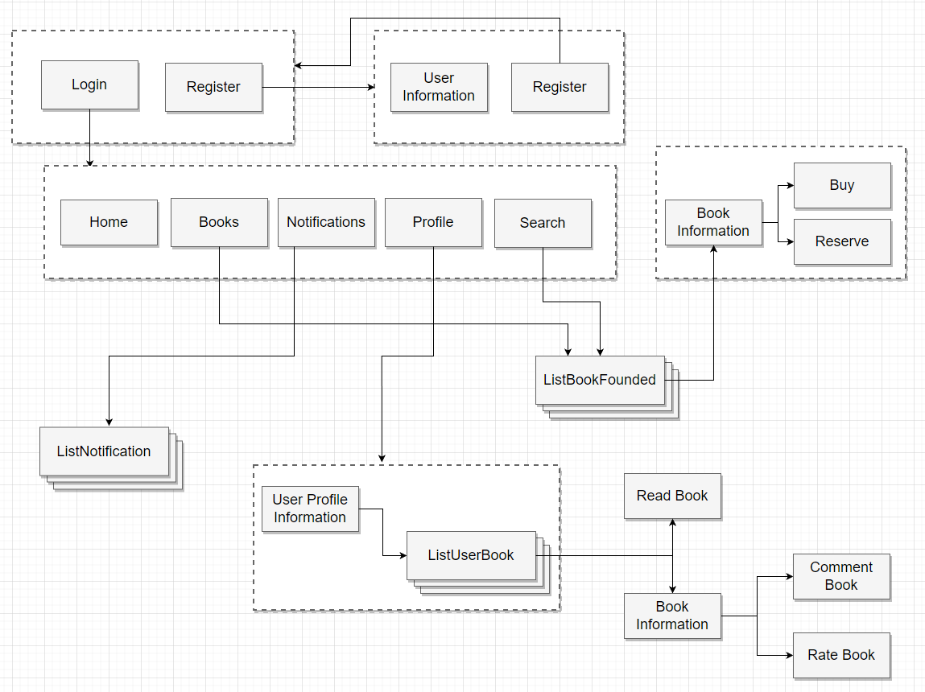
WIREFLOW

Slide 25
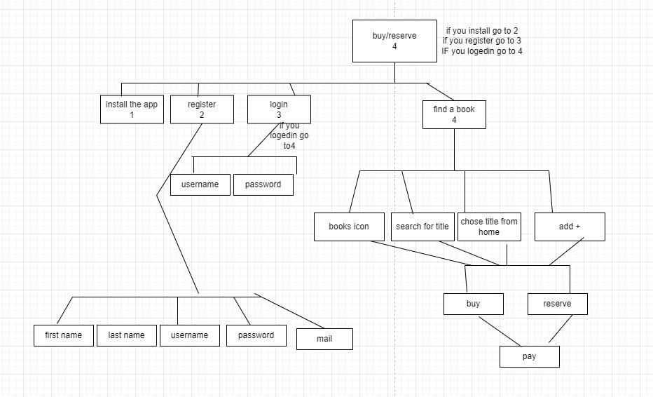
HTA
BuyOrReserve

Slide 26
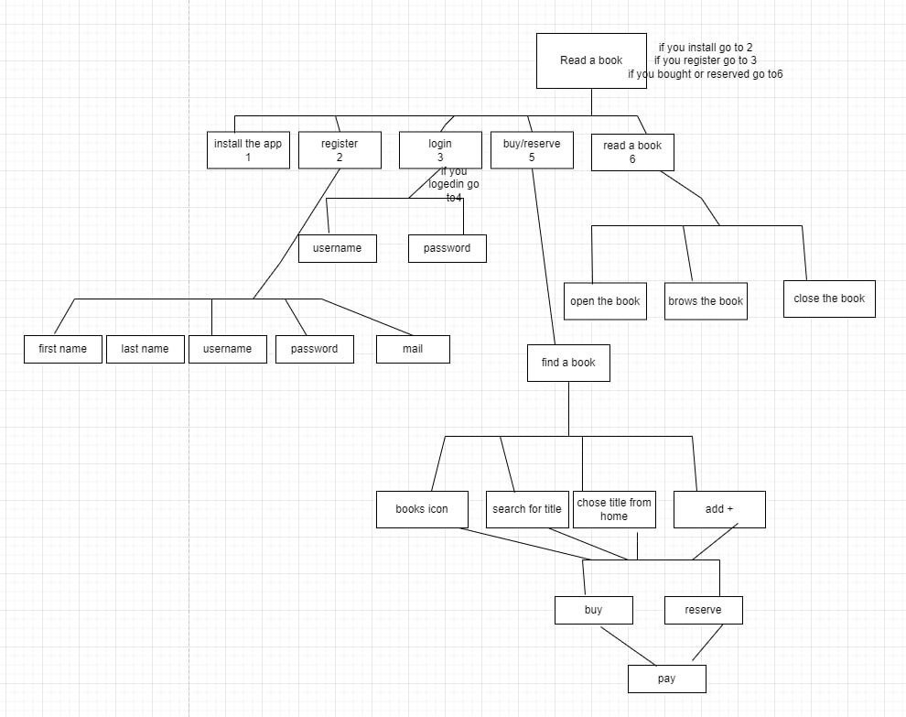
HTA
Read a Book

Slide 27
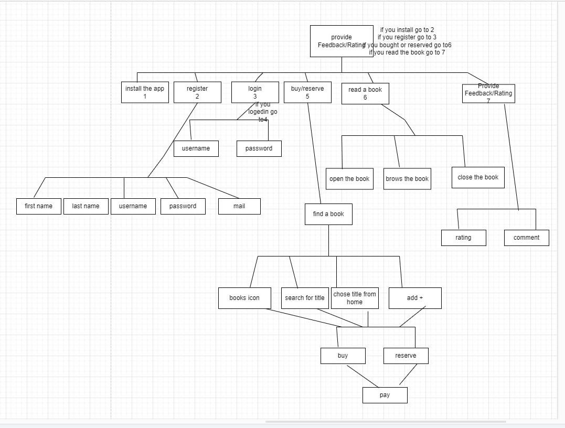
HTA
FeedbackOrRating

Slide 28
Tabla de Contenidos
Wireflow& HTA
01.
03.
Arquitectura de la información
05.
Prototipos
02.
Mapa de Navegación
04.
Bocetos

Slide 29
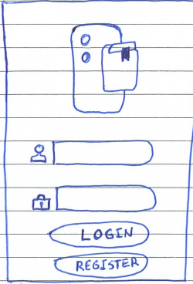
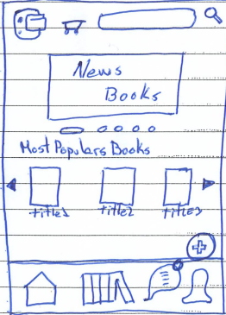
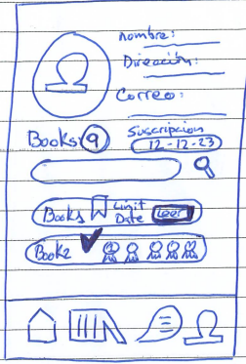
Bocetos
Login
Home
Profile

Slide 30
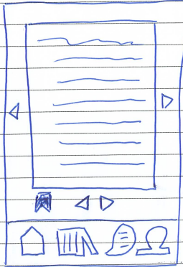
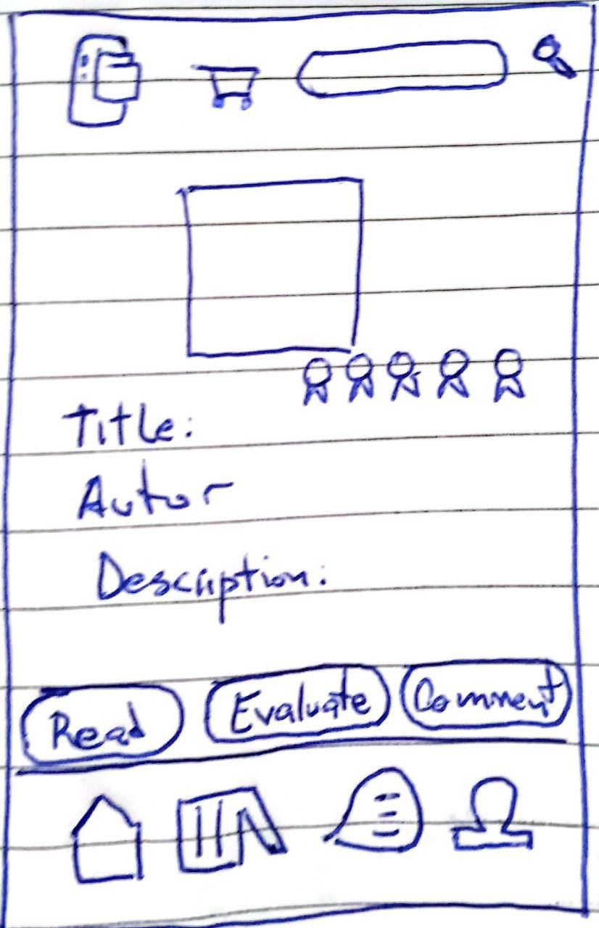
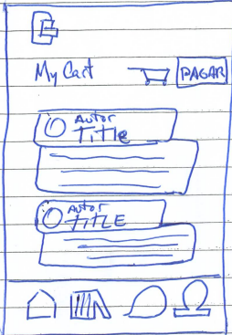
Bocetos
Read
MyBook
Cart

Slide 31
Tabla de Contenidos
Wireflow& HTA
01.
03.
Arquitectura de la información
05.
Prototipos
02.
Mapa de Navegación
04.
Bocetos

Slide 32
Prototipos
Baja Fidelidad
Alta Fidelidad

Slide 33
Prototipos
Baja Fidelidad
Alta Fidelidad

Slide 34
LibroWave
OSCAR MANUEL CONCEPCION NAPOLES
MARYAM NADHIM EDAM, EDAM
SMAIL DAHMANI

